Slide 1
LAB 2
Installation of Linux (Ubuntu)
Instructor Name:
Numan Shafi

Slide 2
Linux (Ubuntu) Installation
There are 3 main methods for accessing Linux OS on your devices:
Virtualization
This involves running Linux as a guest operating system inside a virtual machine (VM) hosted by your primary OS (Windows, macOS, etc.).
Popular VM programs include VirtualBox, VMware, and Hyper-V.
This method allows you to run Linux alongside your existing OS without making permanent changes to your device.
It's good for experimentation, learning Linux, and running software incompatible with your main OS.

Slide 3
Linux (Ubuntu) Installation
Windows Subsystem for Linux (WSL)
This is a Microsoft feature that lets you run a Linux distribution directly within Windows 10 or 11.
It uses virtualization but offers a more seamless integration with Windows, allowing you to run Linux commands and access files from both environments.
WSL is ideal for developers who need to use Linux tools alongside Windows applications.

Slide 4
Linux (Ubuntu) Installation
Booting the device with Linux OS
This involves installing Linux directly onto your device's hard drive, replacing your existing OS or running alongside it in a dual-boot configuration.
This method gives you full access to Linux and its capabilities, but it's more permanent and requires more technical knowledge than the other options.
It's best for users who want to make Linux their primary OS or need full hardware compatibility.

Slide 5
Linux (Ubuntu) Installation
VMware, Inc. is a subsidiary of Dell Technologies that provides cloud computing and platform virtualization software and services
Was the first commercially successful company to virtualize the x86 architecture

Slide 6
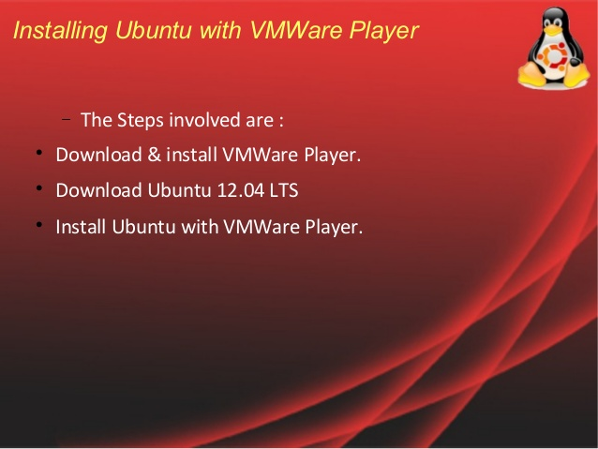

Slide 7
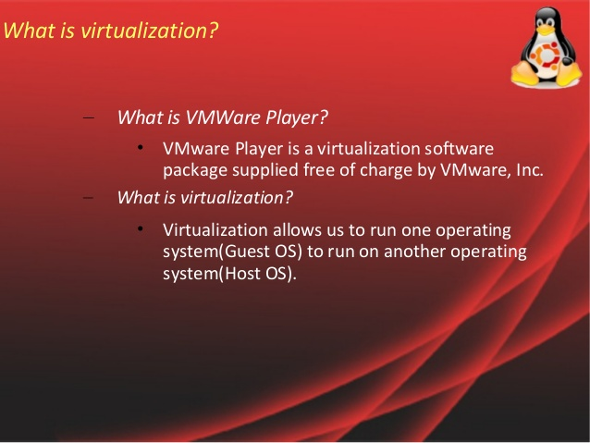

Slide 8
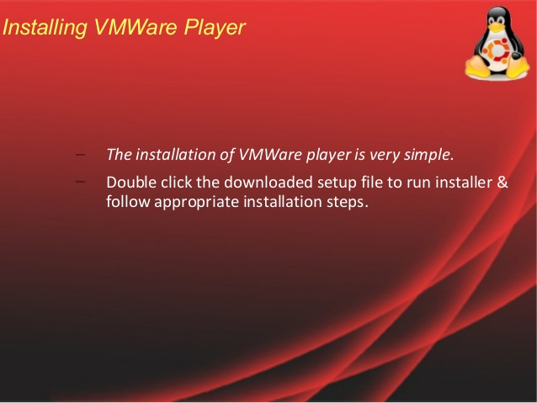

Slide 9
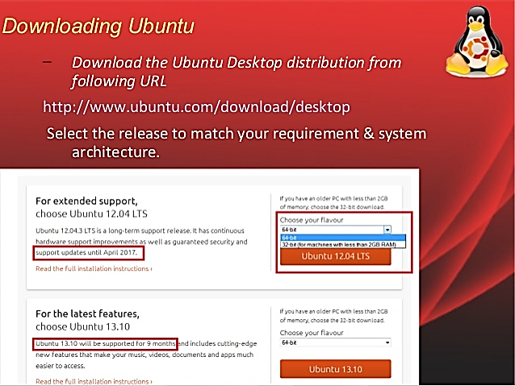

Slide 10
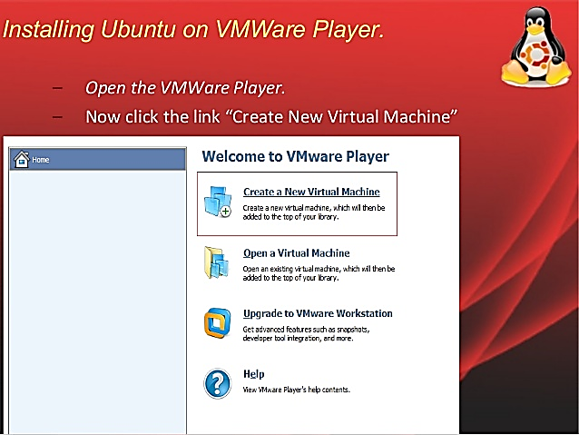

Slide 11
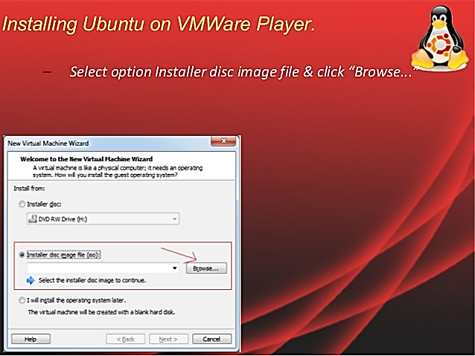

Slide 12
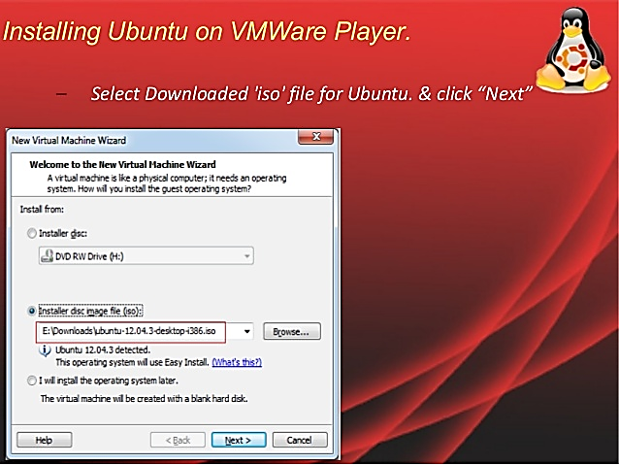

Slide 13
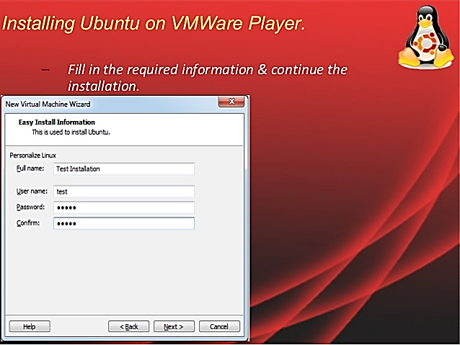

Slide 14
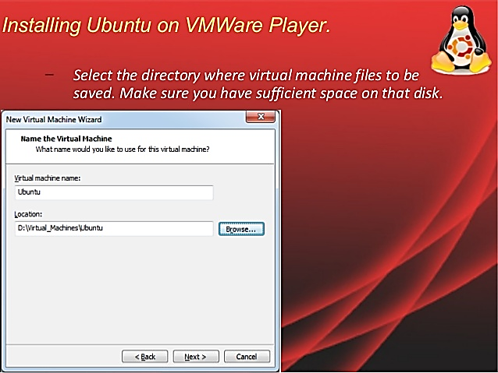

Slide 15
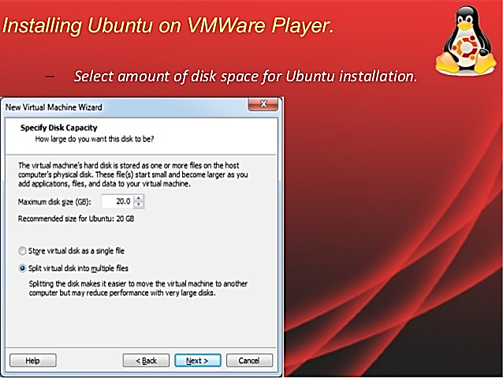

Slide 16
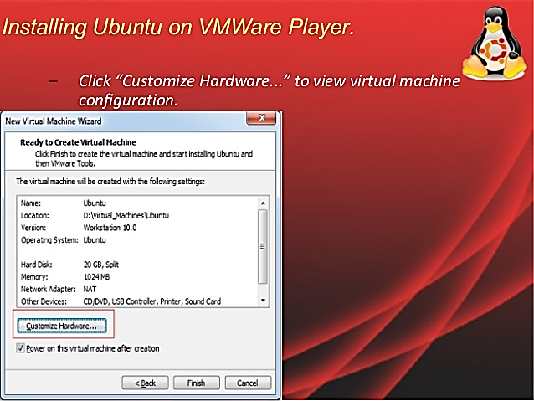

Slide 17
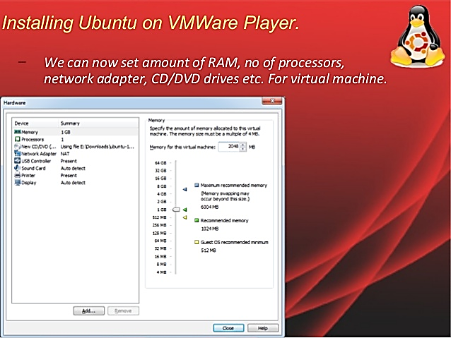

Slide 18
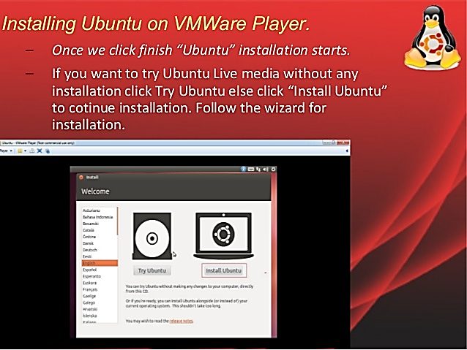

Slide 19
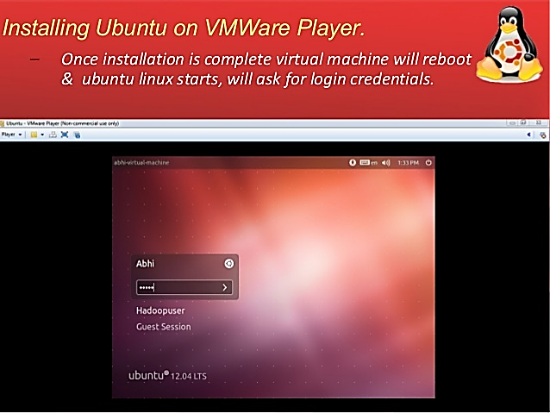

Slide 20
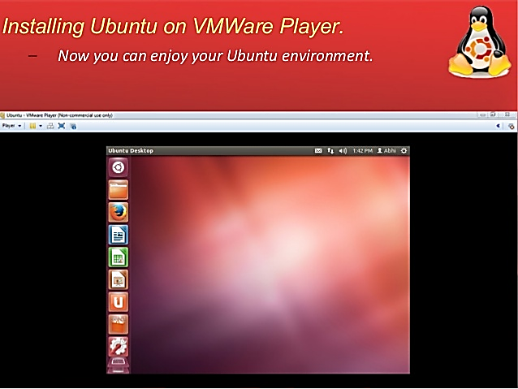

Slide 21

WSL (Windows subsystem for linux)
Following are the WSL commands:
For installing WSL with ubuntu as default distribution:
Command: wsl --install

Slide 22
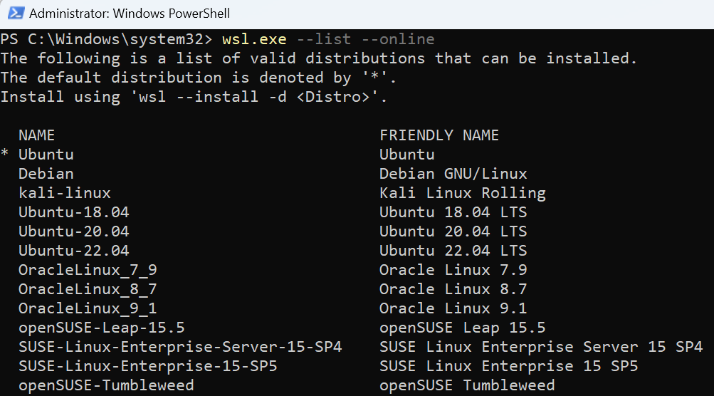
WSL (Windows subsystem for linux)
Following are the WSL commands:
Check which distributions are available
Command: wsl --list --online

Slide 23
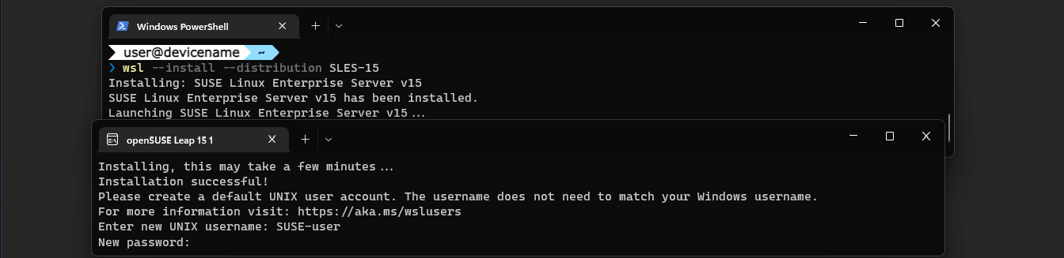
WSL (Windows subsystem for linux)
Following are the WSL commands:
Install a new distribution:
Command: wsl --install <Distribution Name>
For more information visit: https://learn.microsoft.com/en-us/training/modules/wsl-introduction/

Slide 24
Dual Booting the device
Dual booting the device is a little bit complex and requires caution when doing so. We will not go into details in this section but for the students willing to explore this at their own risk can try the following link to view the step by step guide to dual boot their devices.
Dual booting step by step guide: https://www.xda-developers.com/dual-boot-windows-11-linux/

Slide 25
Compilers Installation
Following compilers are used for C and C++ language:
For C language: gcc
Command: sudo apt-get install gcc
For C++ Language: g++
Command: sudo apt-get install g++

Slide 26
Test g++ Compiler Installation
Create file by right click and name it as “test.cpp”
Add this code into file and save:
Compile this code using following steps:
To compile: g++ -o obj test.cpp
To run: ./obj
Done, Check the output on command prompt
#include<iostream>
using namespace std;
int main()
{
cout<< “Testing G++ Compiler!!!!!!!”;
cout<< “Yes, G++ Compiler working Perfectly!!!!!!!”;
return 0;
}

Slide 27
Test gcc Compiler Installation
Create file by right click and name it as “test.c”
Add this code into file and save:
Compile this code using following steps:
To compile: gcc -o obj test.c
To run: ./obj
Done, Check the output on command prompt
#include<stdio.h>
void main() {
printf("Hello! This is my first C program with Ubuntu 11.10\n"); /* Do something more if you want */
}

